Slide 1
Matrix Algebra
2.1 Matrix Operations
Bumhee Cho

Slide 2

Matrix Notation
Column j
Row i
a₁
a_{j}
a_{n}

Slide 3
Matrix Sum
A + B
Scalar Multiple
rA

Slide 4
Theorem 1.
Let A, B, and C be matrices of the same size, and let r and s be scalars.
A + B = B + A
(A + B) + C = A + (B + C)
A + 0 = A
r(A + B) = rA + rB
(r + s)A = rA + sA
r(sA) = (rs)A

Slide 5
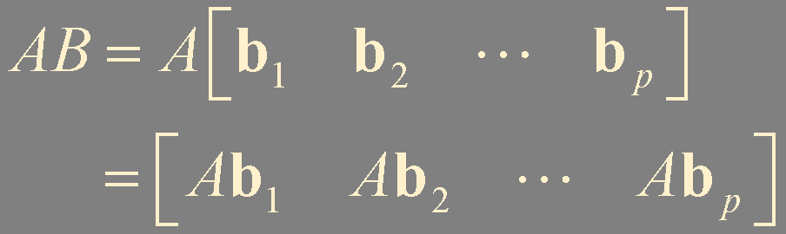

Matrix Multiplication
A(Bx) = (AB)x
If A is m × n matrix, and if B is an n × p matrix with columns b₁, … , b_{p}, then the product AB is the m × p matrix whose columns are Ab₁, … , Ab_{p}. That is,

Slide 6
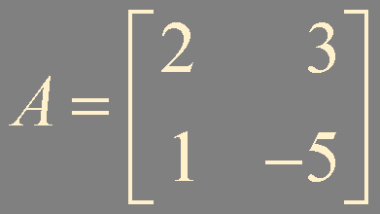
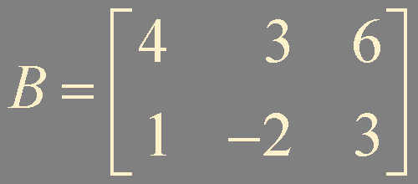
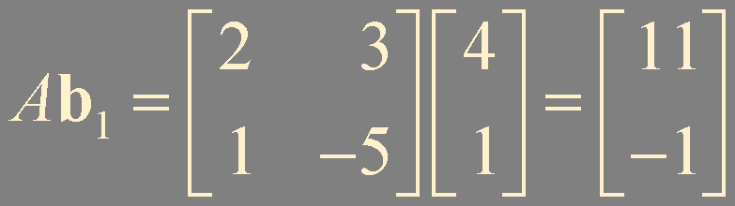
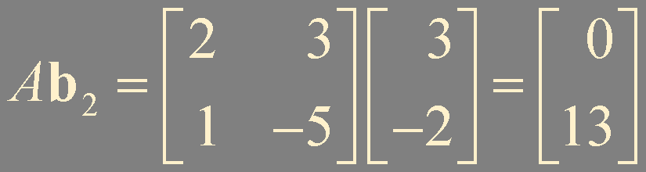
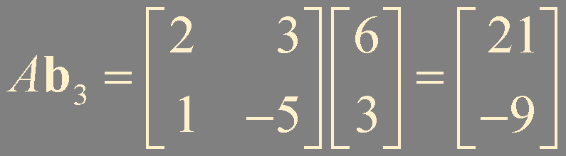
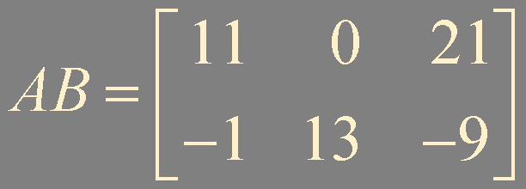
Example 1.

Slide 7
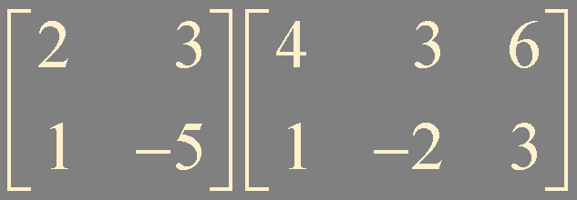
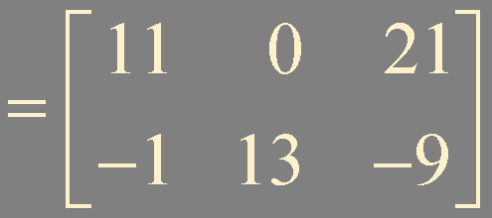

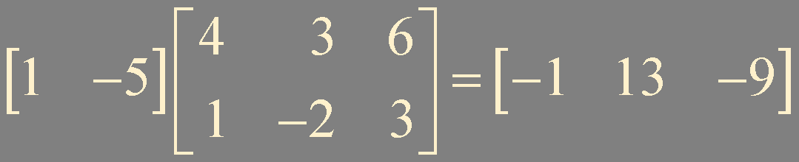
1st row of AB
2nd row of AB
row_{i}(AB) = row_{i}(A)⋅B

Slide 8
Theorem 2.
Let A be an m × n matrix, and let B and C have sizes for which the indicated sums and products are defined.
A(BC) = AB(C)
A(B + C) = AB + AC
(B + C)A = BA + CA
r(AB) = (rA)B = A(rB) for any saclar r
I_{m}A = A = AI_{n}

Slide 9
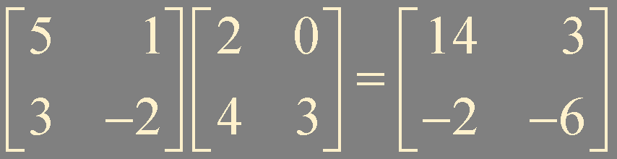




Warnings
In general, AB ≠ BA
If AB = AC, then
it is not true in general that B = C
If AB = 0, then
it is not true in general that either A = 0 or B = 0
If AB = BA, A and B commute with one another

Slide 10

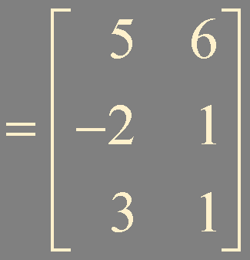

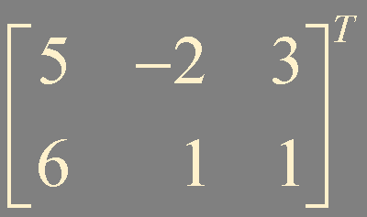


The Transpose of a Matrix
Given an m × n matrix A, the transpose of A is the
n × m matrix, denoted by A^{T},
whose columns are formed from the corresponding rows of A

Slide 11


Theorem 3.
Let A and B denote matrices whose sizes are appropriate for the following sums and products.
(A^{T})^{T} = A
(A + B)^{T} = A^{T} + B^{T}
For any scalar r, (rA)^{T} = rA^{T}
(AB)^{T} = B^{T}A^{T}

Slide 12
Summary
Matrix multiplication
Transpose of a matrix

